Slide 1
NLP Applications

Slide 2
Content
Text Summarization
Question Answering System
NER

Slide 3
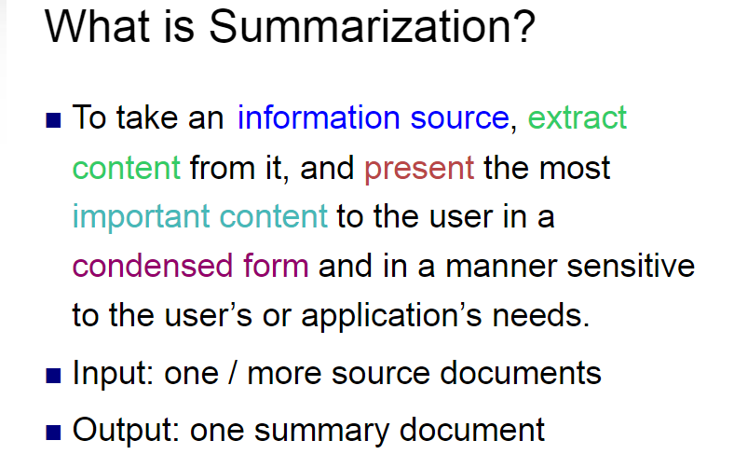

Slide 4
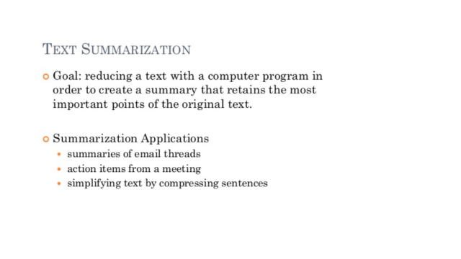

Slide 5
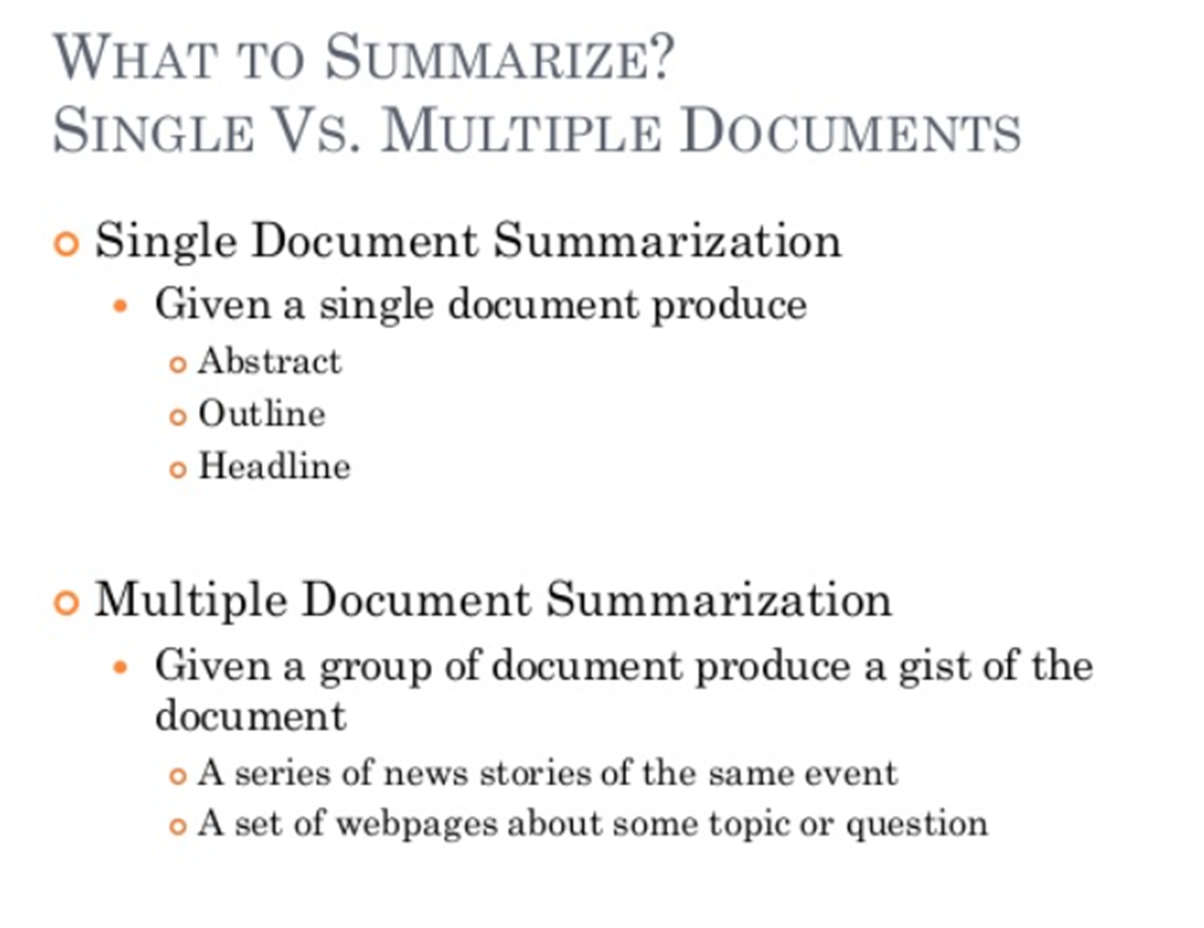

Slide 6
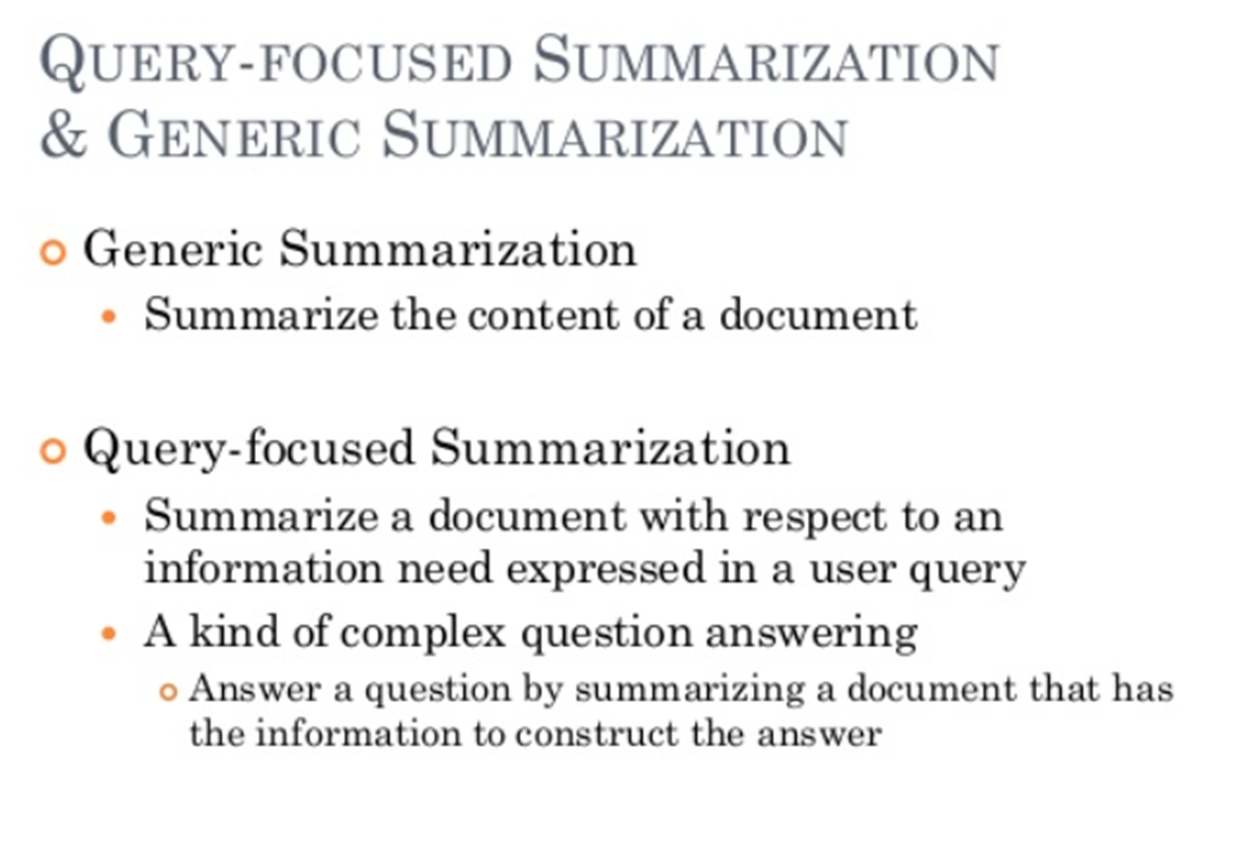

Slide 8
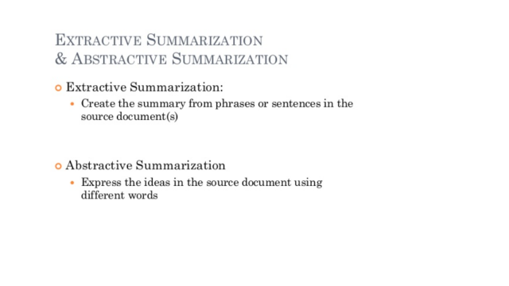

Slide 9
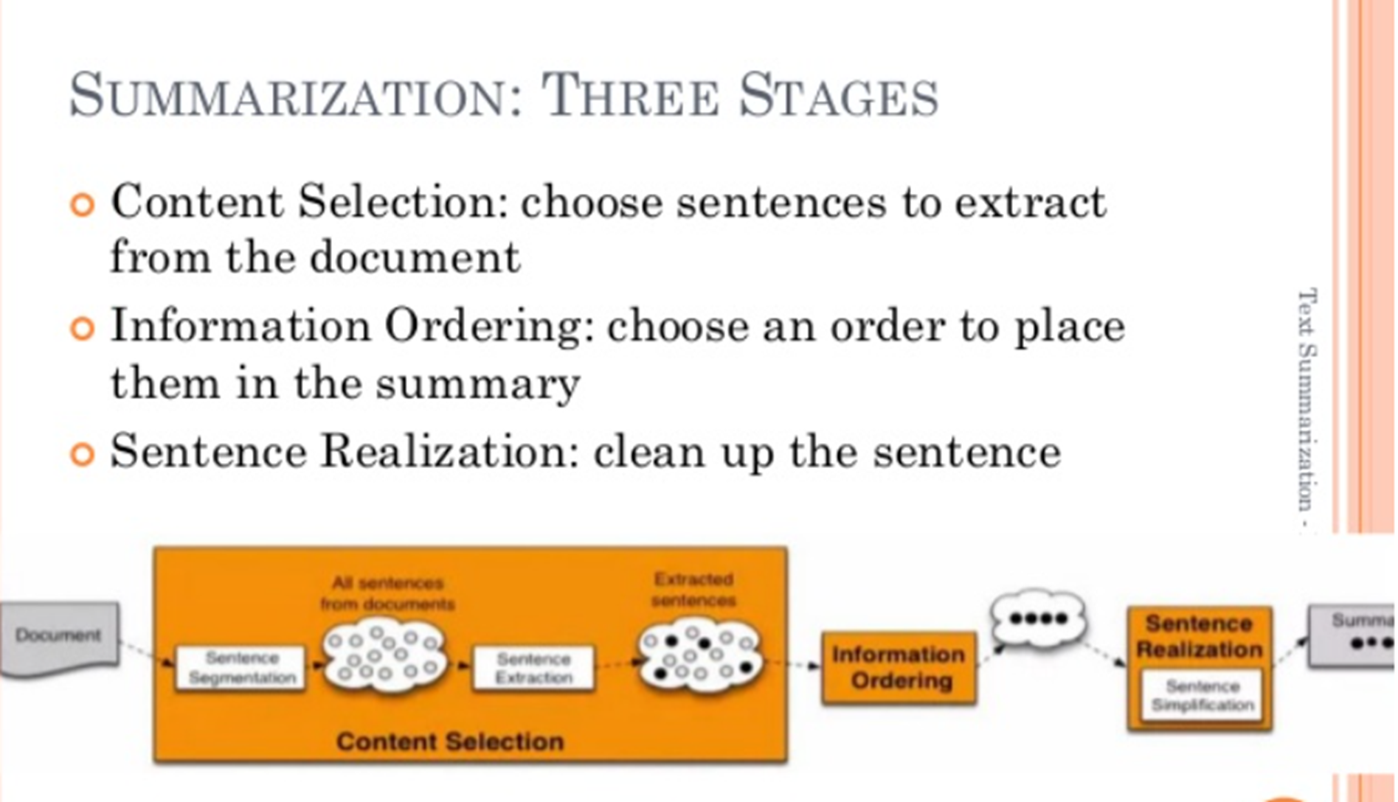

Slide 10
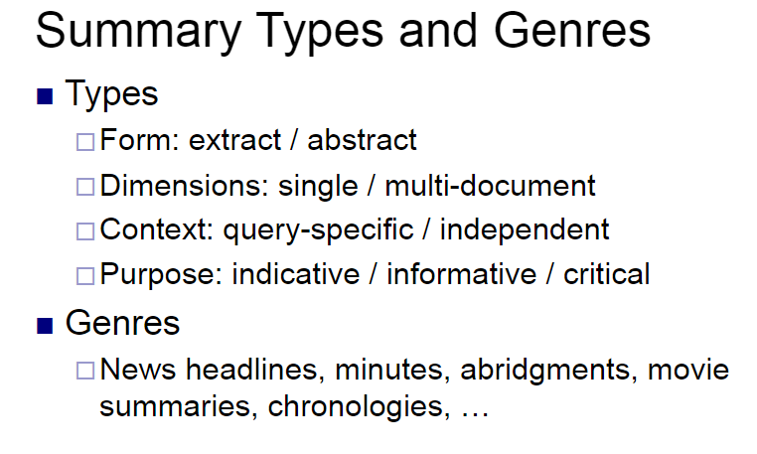

Slide 11
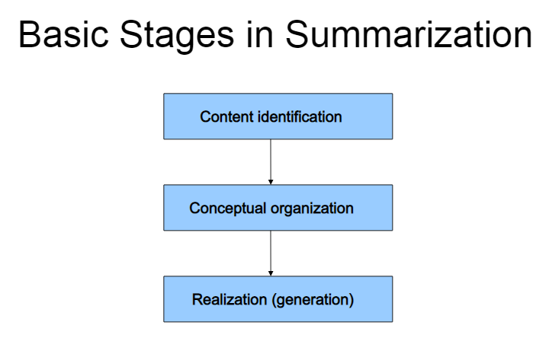

Slide 12
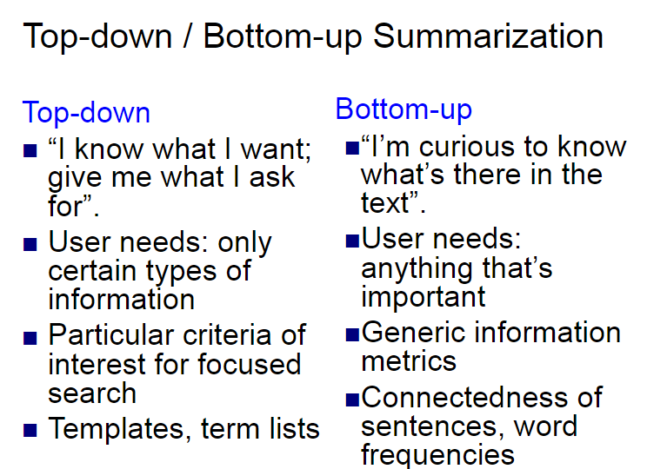

Slide 13
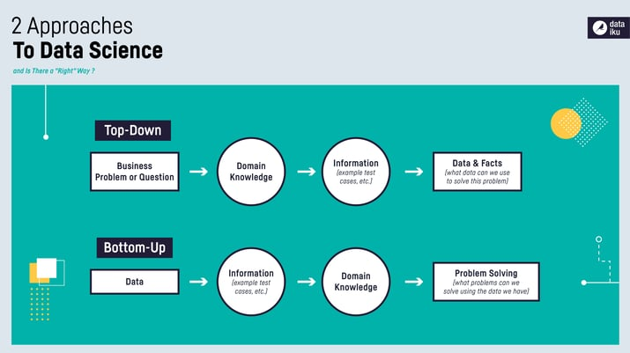

Slide 14
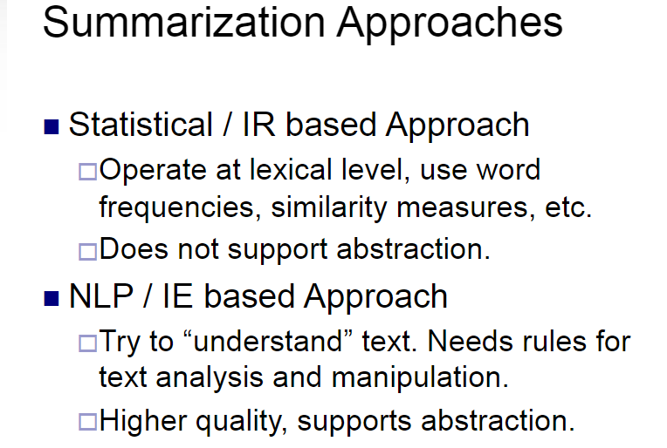

Slide 15
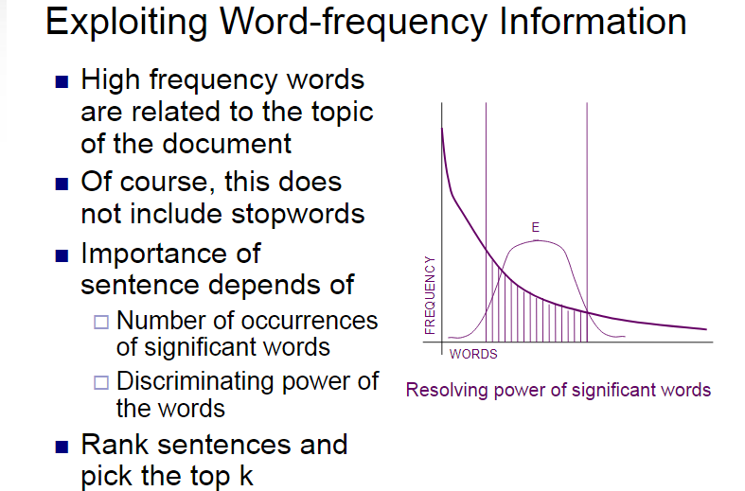
I. Statistical or IR based Approaches

Slide 16
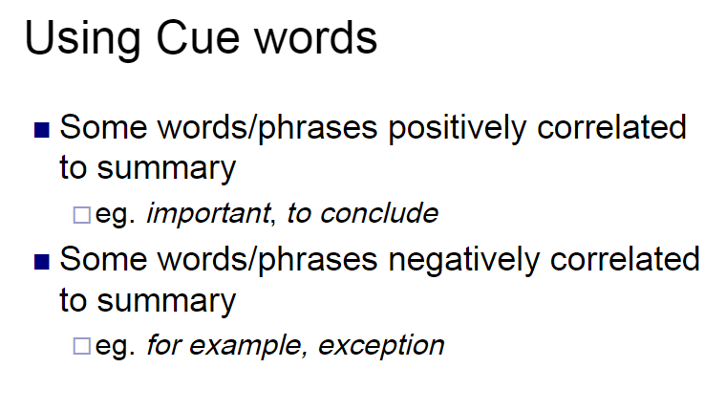
I. Statistical or IR based Approaches

Slide 17
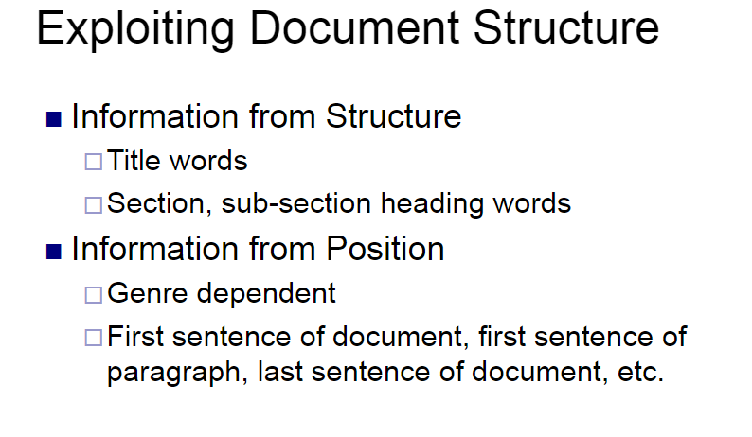

Slide 18
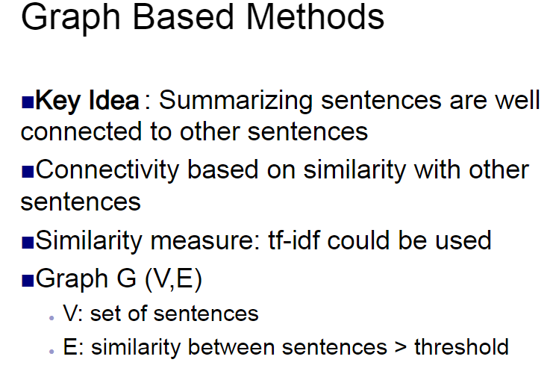

Slide 19
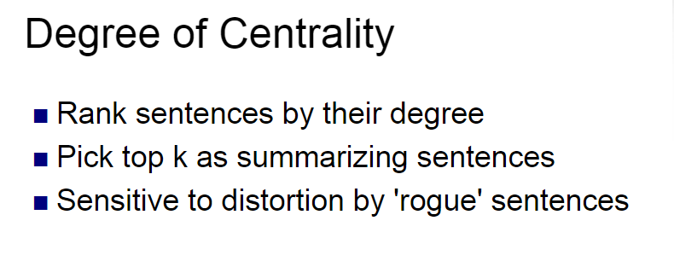

Slide 20
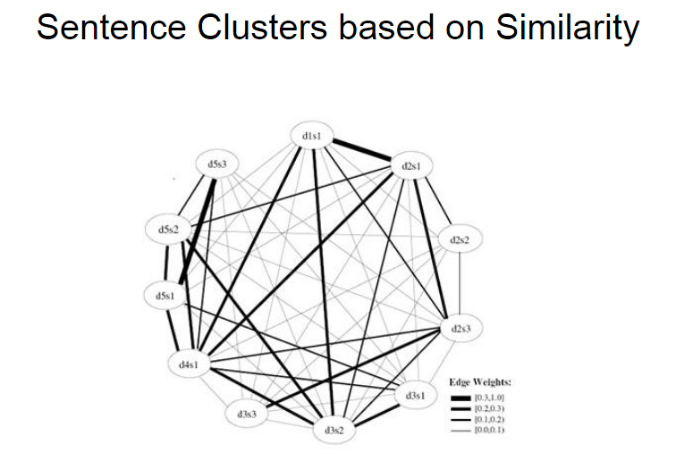

Slide 21
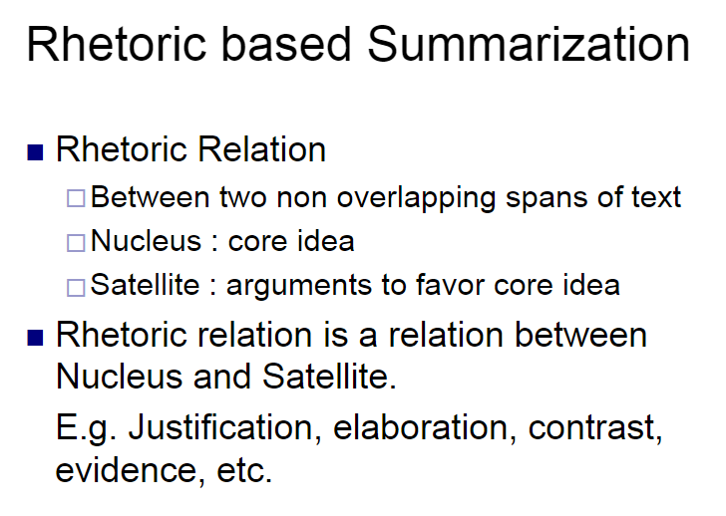
II. NLP/IE based Summarization

Slide 22
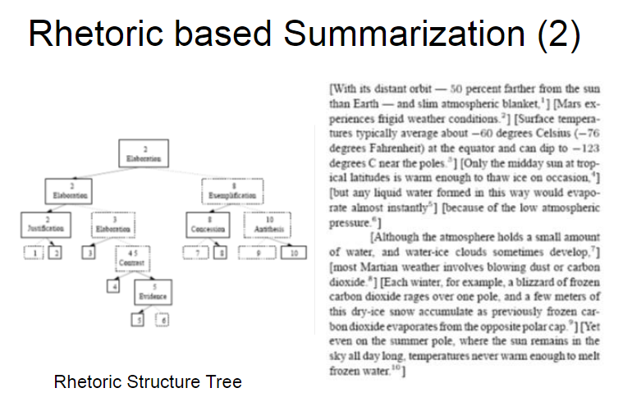

Slide 23
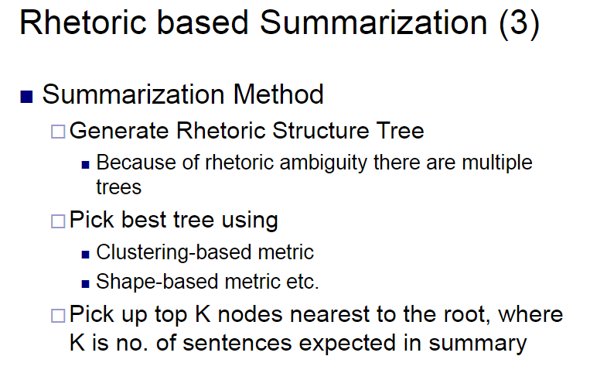

Slide 24
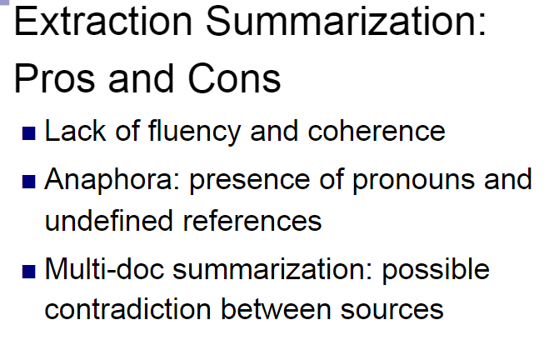

Slide 25
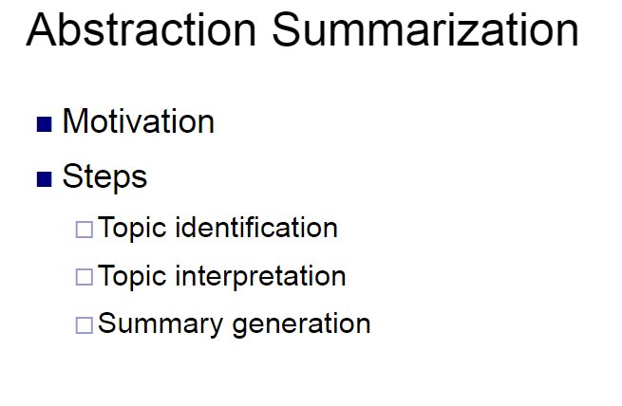

Slide 26
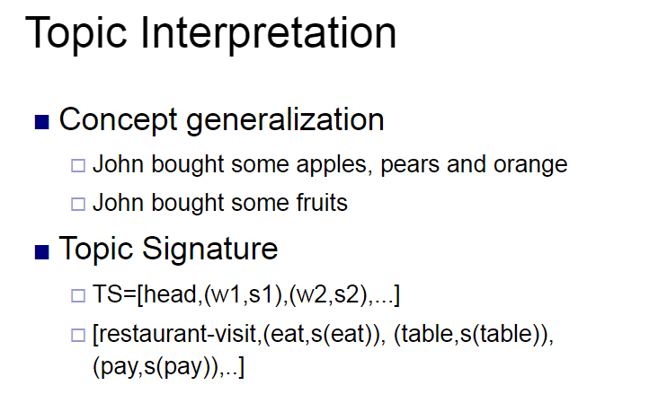

Slide 27
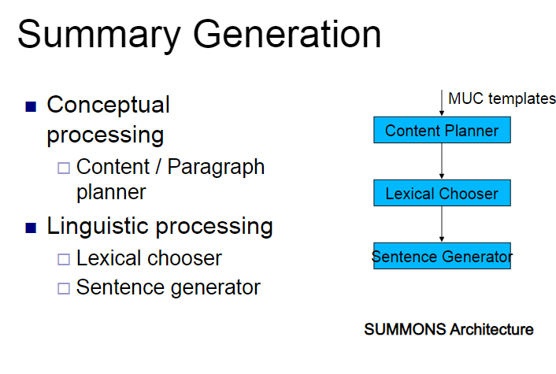

Slide 28
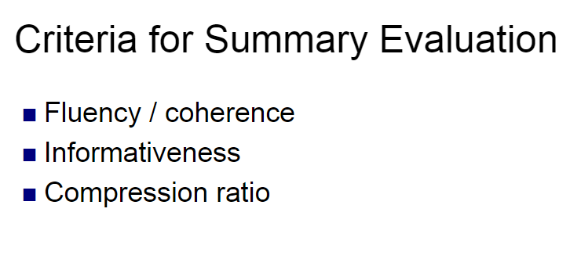

Slide 29
Question Answering

Slide 30
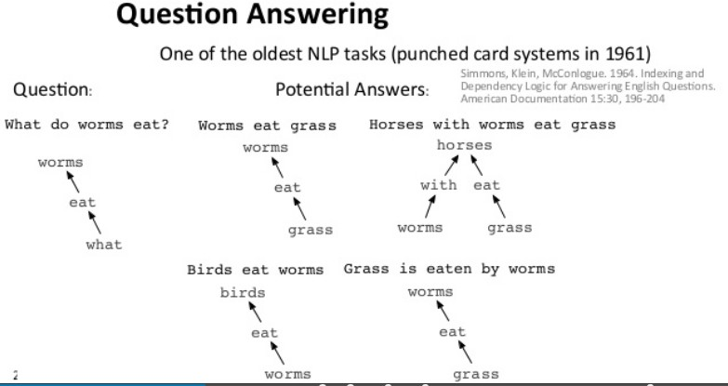
Question Answering System
Question Answering

Slide 31
Question Answering System
Question Answering
Automated Question Answering (QA) is the technology that locates, extracts, and represents a specific answer to a user question expressed in natural language.
A QA system would take as input a question such as “What is mad cow
disease?” and produces the answer, e.g. “Mad cow disease is a fatal disease of cattle that affects the central nervous system”

Slide 32
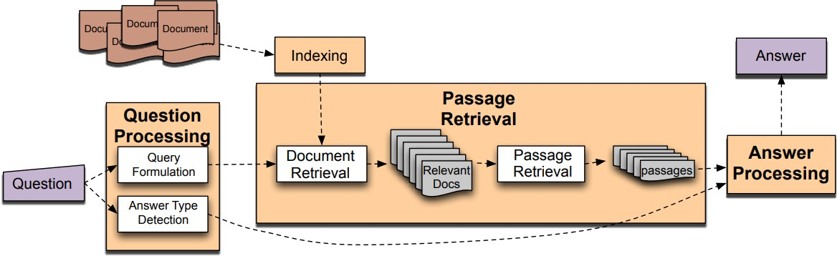
Question Answering System : Basic Diagram
Question Answering

Slide 33
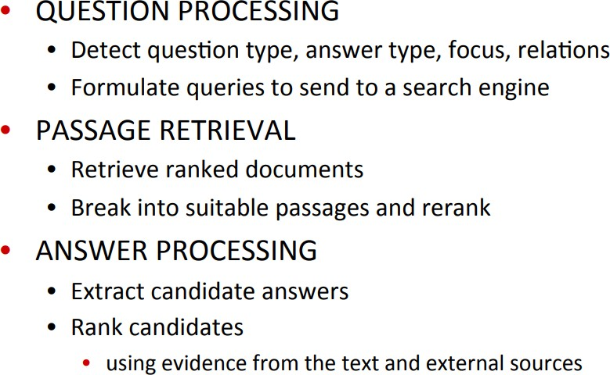
Question Answering System : Basic Diagram
Question Answering

Slide 34
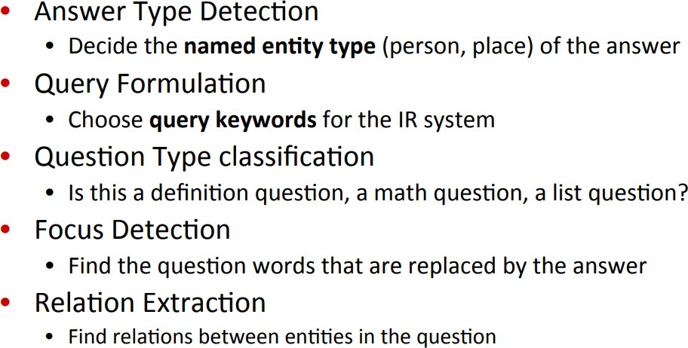
Question Answering System : Basic Diagram
Question Answering

Slide 35
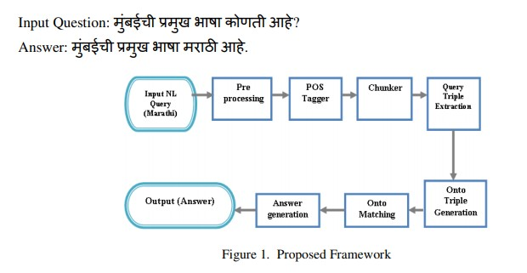
Question Answering System : Marathi QA
Question Answering- Marathi
Source : http://aircconline.com/ijaia/V8N4/8417ijaia05.pdf

Slide 36
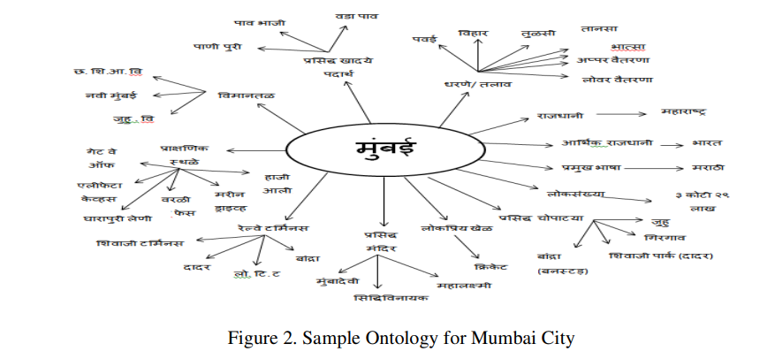
Question Answering- Marathi

Slide 37
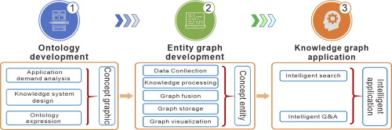

Slide 38
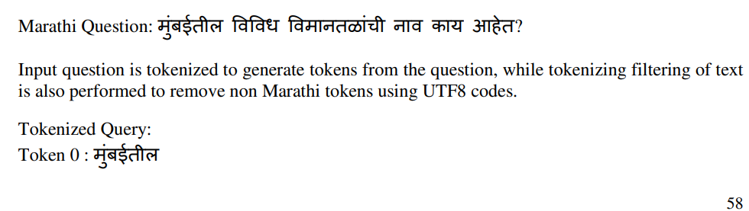
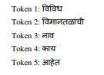
Question Answering : Case Study

Slide 39
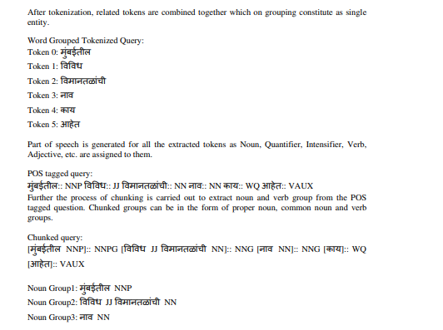
Question Answering : Case Study

Slide 40

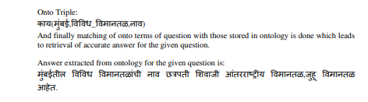
Question Answering : Case Study

Slide 41
Available Resources
Question Answering
WordNet http://wordnet.princeton.edu/
Part-of-speech taggers
TreeTaggerhttp://www.ims.unistuttgart.de/projekte/corplex/TreeTagger/DecisionTree
Tagger.html
Stanford PoS Tagger http://nlp.stanford.edu/software/tagger.shtml
NP chunker
http://www.dcs.shef.ac.uk/~mark/index.html?http://www.dcs.shef.ac.uk/~mark/phd
/software/chunker.html
Parser
Stanford Parser http://nlp.stanford.edu/software/lex-parser.shtml
Other http://nlp.stanford.edu/links/statnlp.html

Slide 42
Named Entity(NE) Recognition

Slide 43
Named Entity(NE) Recognition
What is NE and What is not an NE
How to identify NE
Tagset and Annotation Guidelines
Methods Used in developing NER

Slide 44
Why do NER?
Key part of Information Extraction system
Robust handling of proper names essential for many applications such as Summarization, IR, Anaphora,.........
Pre-processing for different classification levels
Information filtering
Information linking

Slide 45
What is NER ?
NER involves identification of proper names in texts, and classification into a set of predefined categories of interest.
Three universally accepted categories:
Person, location and organisation
Other common tasks: recognition of date/time expressions, measures (percent, money, weight etc), email addresses etc.
Other domain-specific entities: names of Drugs, Genes, medical conditions, names of ships, bibliographic references etc.

Slide 46
NER Definition
Named entity recognition (NER) (also known as entity identification (EI) and entity extraction) is the task that locate and classify atomic elements in text into predefined categories such as the names of persons, organizations, locations, expressions of times, quantities, monetary values, percentages, etc.
John sold 5 companies in 2002.
<ENAMEX TYPE="PERSON">John</ENAMEX> sold <NUMEX TYPE="QUANTITY">5</NUMEX> companies in <TIMEX TYPE="DATE">2002</TIMEX>.

Slide 47
What is not NER?
NER is not event recognition.
NER does not create templates,
NER does not perform co-reference or entity linking,
though these processes are often implemented alongside NER as part of a larger IE system.
NER is not just matching text strings with pre-defined lists of names.
It recognises entities which are being used as entities in a given context.
NER is not an easy task!

Slide 48
Some problems in indentifying NE
Variation of NEs.
Manmohan Singh, Manmohan, Dr. Manmohan Singh
Ambiguity of NE types:
1945 (date vs. time)
Washington (location vs. person)
May (person vs. month)
Tata (person vs. organization)

Slide 49
Ambiguity Examples
Person vs Location
Sir C. P Ramaswamy was the Divan of Travancore (Per)
Sir C.P Ramaswamy Road is in Chennai (Loc)
Person vs Organization
Anil Ambani opened Reliance Fresh (Per)
Reliance Fresh is under Anil Amabani Group Ltd (Org)

Slide 50
More complex problems in NER
Issues of style, structure, domain, genre etc.
Punctuation, spelling, spacing, formatting, ….all have an impact
Dept. of Computing and Information Science
Manchester Metropolitan University
Manchester
United Kingdom
> Tell me more about Leonardo
> Da Vinci

Slide 51
Tagset for Named Entity
ACE tagset is Hierarchical
ACE-Automatic Content Extraction
The tagset
CLIA-is Hierarchical -Similar to ACE
Developed for two domains
Tourism and Health

Slide 52
TAGSET
ENAMEX
Person
Individual
Family name
Title
Group
Organization
Government
Public/private company
Religious
Non-government
Political Party
Para military
Charitable
Association
GPE (Geo-political Social Entity)
Media
Location
Place
District
City
State
Nation
Continent
Address
Water-bodies
Landscapes
Celestial Bodies
Manmade
Religious Places
Roads/Highways
Museum
Theme parks/Parks/Gardens
Monuments
Facilities
Hospitals
Institutes
Library
Hotel/Restaurants/Lodges
Plant/Factories
Police Station/Fire Services
Public Comfort Stations
Airports
Ports
Bus-Stations
Locomotives
Artifacts
Implements
Ammunition
Paintings
Sculptures
Cloths
Gems & Stones
Entertainment
Dance
Music
Drama/Cinema
Sports
Events/Exhibitions/Conferences
Cuisine’s
Animals
Plants

Slide 53
NUMEX
Distance
Money
Quantity
Count
TIMEX
Time
Date
Day
Period

Slide 54
How to Annotate?
1.ENAMEX
1.1 Person
1.1.1 Individual
These refer to names of each individual person, also includes names of fictional characters found in stories/novels etc.
Tag Structure:
<ENAMEX TYPE= “PERSON” SUBTYPE_1= “INDIVIDUAL”> abc </ENAMEX>
Examples:
English:
<ENAMEX TYPE= “PERSON” SUBTYPE_1= “INDIVIDUAL”>Abdul Kalam</ENAMEX>

Slide 55
NE Types
The Named entity hierarchy is divided into three major classes Entity
Name, Time and Numerical expressions.
ENAMEX
NE TYPES
NUMEX
TIMEX

Slide 56
Entity Types

Slide 57
Entity Name Types
Persons are entities limited to humans. A person may be a single individual or a group. Individual refer to names of each individual person. Group refers to set of individual
Location entities are limited to geographical entities such as geographical areas like names of countries, cities, continents and landmasses, bodies of water, and geological formations.
Organization entities are limited to corporations, agencies, and other groups of people defined by an established organizational structure

Slide 58
Numerical Expressions
DISTANCE
QUANTITY
NUMEX
MONEY
COUNT

Slide 59
Numerical Expressions
Distance refers to the distance measures such as kilometers, Centimeters, meters, acres, feet etc.
Example: 10 cm., twenty feet, 15 hectares
Money specifies the different currency value such as rupee, euro, Dinar, dollar etc.
Example: Rs. 1000, 250 Euro, $160
Count denotes the number (or counts) of Items/ articles/things etc.
Example: 5 subjects, 12 students, 20 books
Quantity measurements like liters, tons, grams, volts etc. are comes under this category.
Example: 20 litres, 22 kg, 50g, 100 volts

Slide 60
Time Expressions
TIMEX
TIME
MONTH
DATE
YEAR
DAY
PERIOD
SPECIAL DAY

Slide 61
Temporal Expressions
Temporal expressions are the entities refers to time, date, year, month and day
Time: These refer to expressions of time, includes different forms
of expressing time. This also includes Hours, minutes and seconds.
Example
5’o clock in the morning
9.30 a.m.
Evening 6.30 p.m.
Date: This refers to expressions of Date such as 13/12/2001 etc in
different forms. This also includes month, date and year
Example
August 15 1947
1956
September 11

Slide 62
Temporal Expressions
Day: These are expressions, which convey days in a year. Also it can include
days occurring weekly /fortnightly/ monthly /quarterly/ biennial etc.
Example
Sunday
Tomorrow
Today
Yesterday
Special Day: refers to special days in a year
Example
Gandhi Jayanthi
Rama Navami

Slide 63
Methodologies
Methods:
Rule Based
Machine Learning
Hidden Markov Model (HMM)
Naïve Bayes Classifier
Maximum Entropy Markov Model (MEMM)
Conditional random Fields (CRF)
4) Hybrid Approach
Dictionary Look-up
Rule based ( Using lexical, contextual and morphological information)
Maximum entropy theory based
Hidden Markov Model
Conditional Random Fields
Hybrid methods (Statistical+ Linguistics)

Slide 64
Dictionary (Gazetteers) Look-up Approach
Uses Dictionaries for identifying NERs ( Gazetteers)
Gazetteer contains NEs from all domains
Advantage
Very simple approach
Gives very high precision

Slide 65
Disadvantages of Dictionary Approach
Preparation of exhaustive dictionary is a tedious and expensive process.
The dictionary should cover the different spellings of the same place.

Slide 66
Rule Based Approach
Rule Based System
Needs more rules to tag all kinds of NE
Advantages:
Rich and expressive rules
Good results
Disadvantages:
Requires huge experience and grammatical knowledge
Experts to craft rules are expensive
Highly domain specific ( not portable to a new domain)

Slide 67
General difficulties
“ Italy's business world was rocked by the announcement last Thursday that Mr. Verdi would leave his job as vice-president of Music Masters of Milan, Inc. to become operations director of Arthur Andersen".
• Capitalization useless for first word
• S not part of name "Italy"
• Date is "last Thursday" not "Thursday"
• Milan is location, not organization
• Arthur Andersen is organization, not person

Slide 68
Rules success and failure
Title Capitalized_Word Title Person_Name
Correct: Mr. Jones
Incorrect: Mrs. Field's Cookies (corporation)
Month_name number_less_than_32 Date
Correct: February 28
Incorrect: Long March 3 (a Chinese Rocket)
From Date to Date Date
Correct: from August 3 to August 9
Incorrect: I moved my trip from April to June (two
separate dates)

Slide 69
Statistical based approach
Need to identify features
Feature selection has to be correct for all types of NE
Development of Tagged Corpus
The Corpus should contain all types of tags in appropriate number
Domain based corpus has to be generated.

Slide 70
Automated approaches
Address drawbacks of hand-coded system
Automated training
• Human-annotated (with desired output
standards) training data
• Annotation requires less effort and expertise
than hand-coding rules
• Annotation accuracy
• Two annotators for checking, third annotator to
resolve disputes

Slide 71
Google Translator
Bhashini

